Slide 1

Wave Interactions II
This lesson will introduce you to how motion affects waves
You will also learn how about Beats, Mechanical Resonance and the Doppler effect.

Slide 2
Learning Goals
By the end of this lesson, you will be able to:
explain Beat frequency
explain mechanical resonance
explain the Doppler effect
solve problems involving Beats and the Doppler effect

Slide 3
Success Criteria
Can I:
explain Beat frequency
explain mechanical resonance
explain the Doppler effect
solve problems involving Beats and the Doppler effect
describe a sonic boom

Slide 4
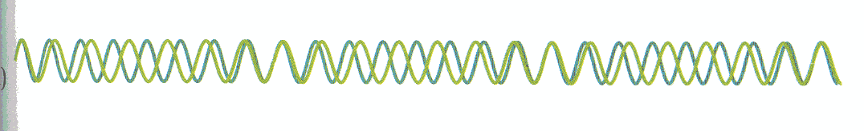
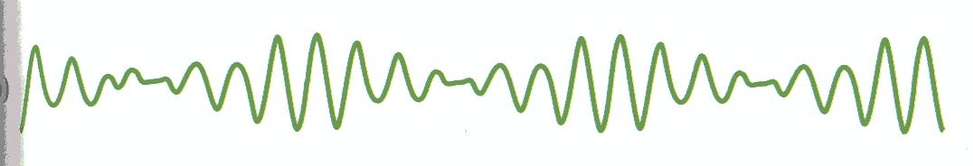
Beat Frequency
When two notes of slightly different freqs are sounded together, the two waves interfere according to the law of superposition.
The result is a complicated wave form.

Slide 5
beat freq refers to the freq of the pulsating noise, and
not the freq of the sources creating the sounds.
it is the number of beats heard per second.
the beat freq is related to the two original sounds, and
can be calculated using the following equation.

Slide 6
click to play animation

Slide 7
Sample Problem
A piano tuner strikes a 256 Hz (middle C) tuning fork and the middle C on a piano. She hears 20 beats in 5.00 s. What are the possible freq of the out-of-tune piano note.
Sol’n:
20 beats are heard in 5.00 s, f_{beat} is 20/5.00 = 4.00 Hz
∴ out-of-tune note is either 260. Hz or 252 Hz

Slide 8
Mechanical Resonance
All objects have a natural frequency.
Take a swing as an example.
If you want the swing to go higher, you have to push
yourself at the right time in order to match your push freq with the natural freq of the swing.
Mechanical resonance is the vibrating response of an object to a periodic force from a source that has the same frequency as the natural frequency of the object

Slide 9
If you match these two frequencies, the amplitude of vibration will start to increase.
So if a source is vibrating with the same freq as the natural freq of another object, it will cause the other object to vibrate with that freq

Slide 10
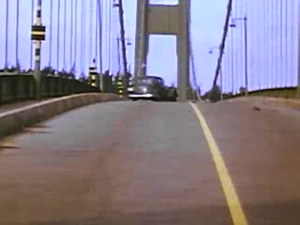

Slide 11
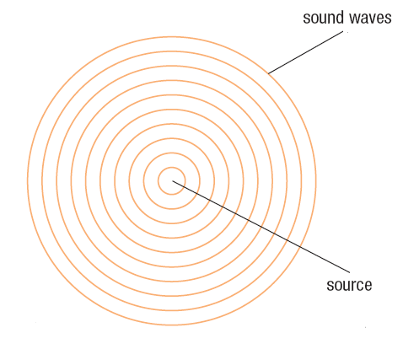
Doppler Effect
sound wave from a stationary source propagate uniformly in concentric spheres

Slide 12
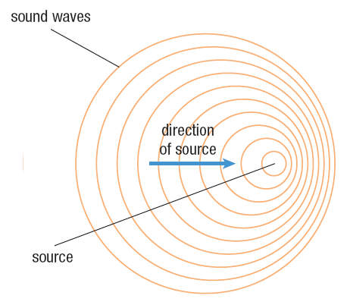
sound wave from a moving source propagate differently, the wavelength shortens in front of the source

Slide 13
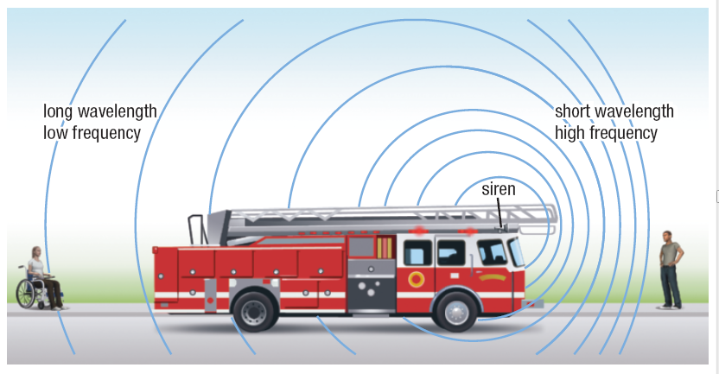

Slide 14
The resulting freq due to motion can be calculated using:
The v_{source} is –’ve if the source is moving towards the detector
The v_{source} is +’ve if the source is moving away from the detector

Slide 15
Sample Problem
A fire truck is moving toward a stationary observer at 25.0 m/s. The frequency of the siren is 800.0 Hz. Calculate
the frequency detected by the observer as the fire truck approaches
the frequency detected by the observer after the truck passes by.
The speed of sound in this case is 342 m/s.?
Sol’n:
f_{o} = 800.0 Hz
v_{sound} = 342 m/s
v_{source} = -25.0 m/s
v_{detector} = 0 m/s

Slide 16
∴ The siren frequency sounds to be 863 Hz
Sol’n b:
f_{o} = 800.0 Hz
v_{sound} = 342 m/s
v_{source} = +25.0 m/s
v_{detector} = 0 m/s
∴ The siren frequency sounds to be 746 Hz

Slide 17
Sonic Booms
As an aircraft approaches the speed of sound, the compressions from the sound waves begin to build up at the front of the aircraft.
This creates an area of intense air molecule compression, and the air pressure is very large. This is called the sound barrier.
The aircraft is catching up with its own jet noise.

Slide 18
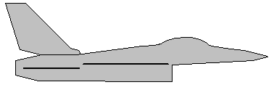
v < Mach 1
Wave fronts begin
to bunch up at front

Slide 19
v=Mach1
Area of intense
compression.
The Sound Barrier

Slide 20
Aircraft is moving
faster than its own
sound waves.
v>Mach1
A sonic boom is created

Slide 21
HOMEWORK
Read Sections 9.3, 9.4, and 9.5
Questions 1 – 4 pg 429
1 – 2 pg 435
1 – 4 pg 435

